Slide 1
SDS PROJECT Work
Team Members: Bhargav , Deepthi ,Dev , Gourav
Dataset : Delhi weather

Slide 2
Finding the relations between factors affecting weather
Choosing an appropriate sample
Normalization and Standardization
Selecting the dataset
Cleaning the dataset
Data Visualization
Hypothesis Testing and Correlations

Slide 3
Selecting the dataset
Choosing an appropriate sample
Normalization and Standardization
Cleaning the dataset
Data Visualization
Hypothesis Testing and Correlations

Slide 4
Selecting a dataset
We wanted to find out the factors affecting the weather in Delhi. We found a dataset about the weather in Delhi from the years 1997-2017. This was over a period of 20 years. This dataset is available on Kaggle.
This data was taken out of wunderground with the help pf their easy to use API. It contains various features such as temperature,pressure,rain,humidity,precipitation and many more. We shall explain this in more detail going forward.

Slide 5
Features of our dataset
There are many columns that specify about the conditions of the weather.
We have a date-time column at the start. They are in the intervals of 3 hours.
We have categorical variables like the Conditions and Wind Direction.
We have numerical data such as Dew point ,Humidity ,Pressure, Visibility Temperature, and Wind direction.
We have Boolean data such as Rain ,Snow ,Thunder, Tornado, Hail and Fog.

Slide 6
Features of our dataset
The conditions column define what type of weather it was in a short description format such as light haze, rain, heavy fog and others.
The numerical data like precipitation, humidity among others have a range of values and based on these factors we can get a correlation among these.
The Boolean values just signify whether the specific event occurred or not. 1 signifying that it has happened and 0 signifying otherwise.

Slide 7
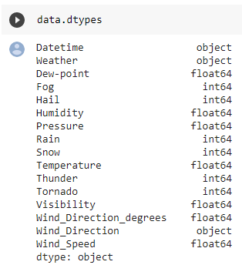
Data types
These are the data types of each of our column

Slide 8
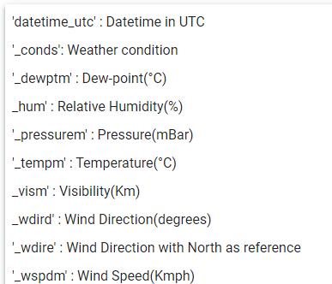
Brief Description of the columns
This just a brief description of the columns. We have told what do each of the columns consist of and what they describe. We will try to find relations between these in our study of the weather.

Slide 9
Choosing an appropriate sample
Normalization and Standardization
Selecting the dataset
Cleaning the dataset
Data Visualization
Hypothesis Testing and Correlations

Slide 10
Data Cleaning
We have to clean our data to make it more reliable and credible so that we can be sure that the conclusions that we will form will be right and be more efficient as errors in the data can be harmful and decrease the credibility of our conclusions. We initially decided that the weather would have had a large change due to climate change and hence decided to take the values from 2007-2017 instead.
We have to remove the null values and take care of outliers that are present in the dataset so that we can arrive at a cleaned dataset ready for us to visualize.
We decided to first check the null values of each column.

Slide 11
Data Cleaning-Formatting data
We also wanted to ensure we can use the date format as a timestamp as it allows us to work more freely with the date. Therefore we changed the data type of the date from an object to a timestamp.
We also changed the wind direction to represent 8 cardinal points as that allows more freedom to analyze it.

Slide 12
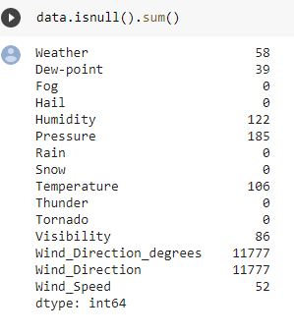
Data Cleaning-Handling Null Values
We found that there are few null values for the columns.We needed to replace these null values as we did not want to lose the data. We decided to use a interpolate method to do so. We will take a look at how the interpolate method works.

Slide 13
Interpolate method
Interpolation is the process of estimating unknown values that fall between two known values. There are various methods for interpolating missing data, so here we have interpolated based on the time interval between two known values. This takes care of the condition that, if the timestamp of the missing data entry for a particular variable is closer to one of the two known values for that variable, then the interpolated value is closer to that know value.

Slide 14
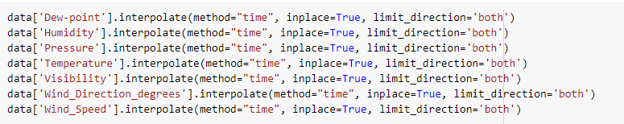
Data Cleaning- Handling Null Values
We used the interpolate function in pandas as mentioned and implemented the following code on the dataset.

Slide 15
Data Cleaning-Handling Null values
We can use the interpolate method for those type of data but the same can’t be applied to the categorical data of the conditions of the data. Since we didn’t want to lose any data, we decided we are going to replace it with just a MISSING as by removing them it could result in loss of key data.

Slide 16
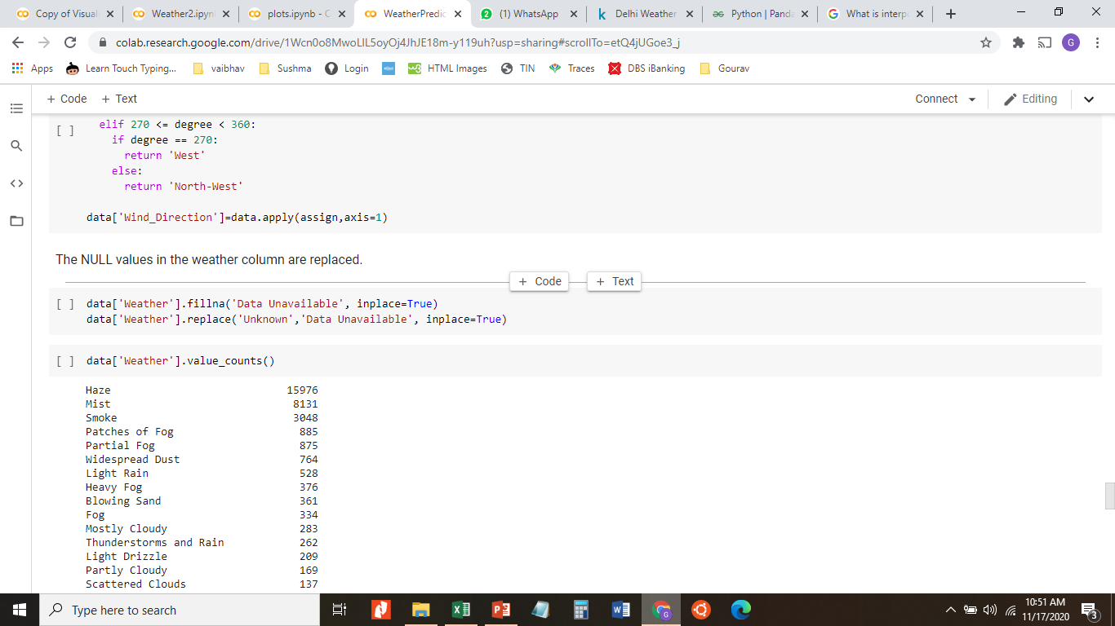
Data Cleaning-Handling Null Values
Using the above code we managed to replace the null values in the conditions column and this ends our handling of null values.

Slide 17
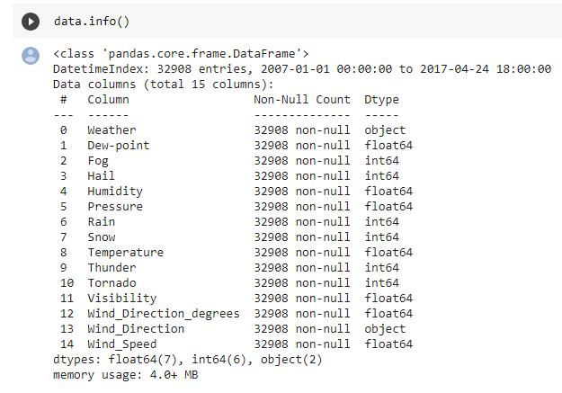
Data Cleaning-Handling Null Values
To confirm that there are no more null values in the data we ran the code on the right to find out about the data in general. We can see that there are no more null values in the dataset.

Slide 18
Data Cleaning-Handling Outliers
Since we needed to visualize the data to find the outliers in our data we decided that as we are about to visualize the data we will handle the outliers and remove them then.

Slide 19
Choosing an appropriate sample
Normalization and Standardization
Selecting the dataset
Cleaning the dataset
Data Visualization
Hypothesis Testing and Correlations

Slide 20
Choosing an appropriate sample
We have to take many factors into consideration for the sample selection. We noticed during our visualization section that taking too many values can lead it to being cluttered and hard to understand. Therefore we decided to take a month’s data as our sample.
When we generalize the data to the population we can generalize it only for the specific month of the year. We have done the study for a month selected at random being the Septemeber 2016. Our code is written in such a manner that we can input which month we want and visualize its data and understand the trends of that month. Due to time constraints we could do only for the one month we have selected at random.

Slide 21
Selecting the dataset
Choosing an appropriate sample
Normalization and Standardization
Selecting the dataset
Cleaning the dataset
Data Visualization
Hypothesis Testing and Correlations
Normalization and Standardization

Slide 22
Data Visualization
We decided to use box plots first to see how our data is distributed initially. We have drawn box plots to compare for the various factors that are mentioned in the dataset. We also did individual box plots for the factors of the sample that we have selected. We take the input for the date and time for whatever month we want and we have selected the month of September 2016.

Slide 23
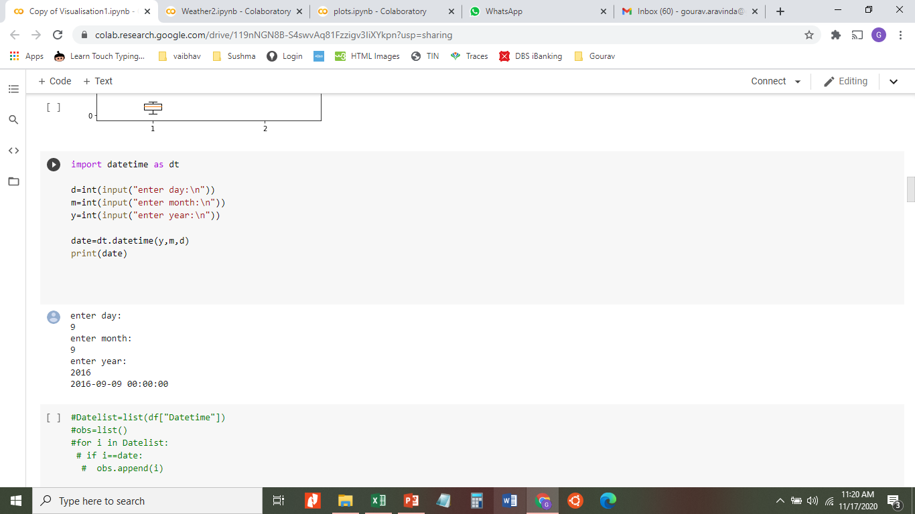
Data Visualization-Taking Date Input
We use the code on the right to take the input of date. We have given the month that we selected at random.

Slide 24
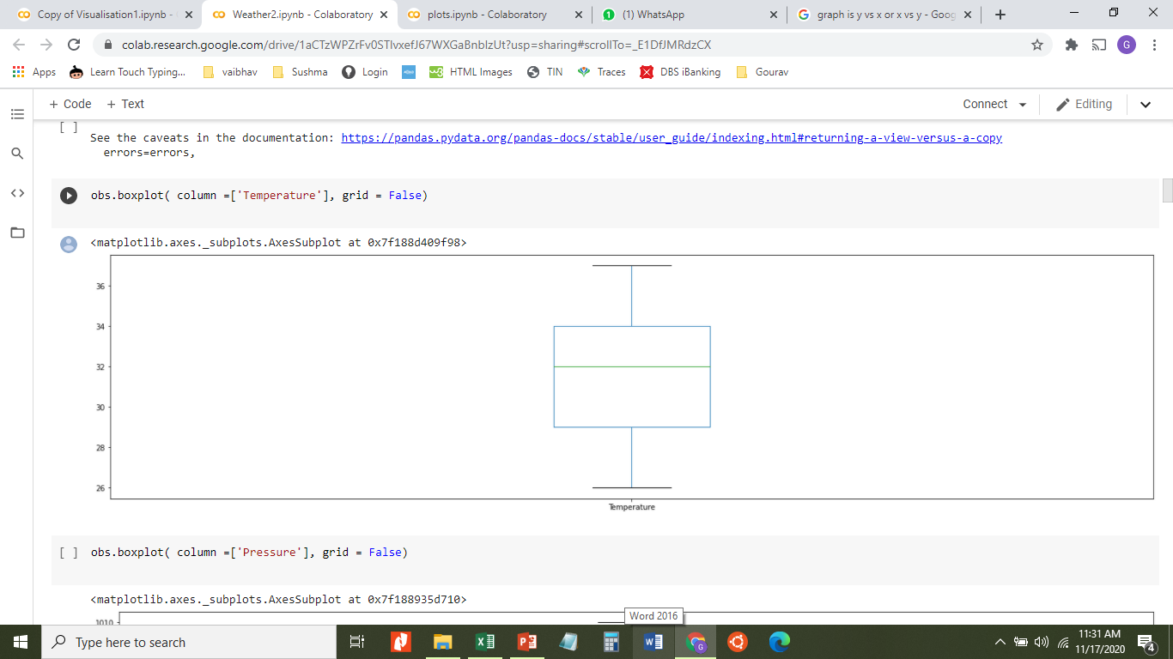
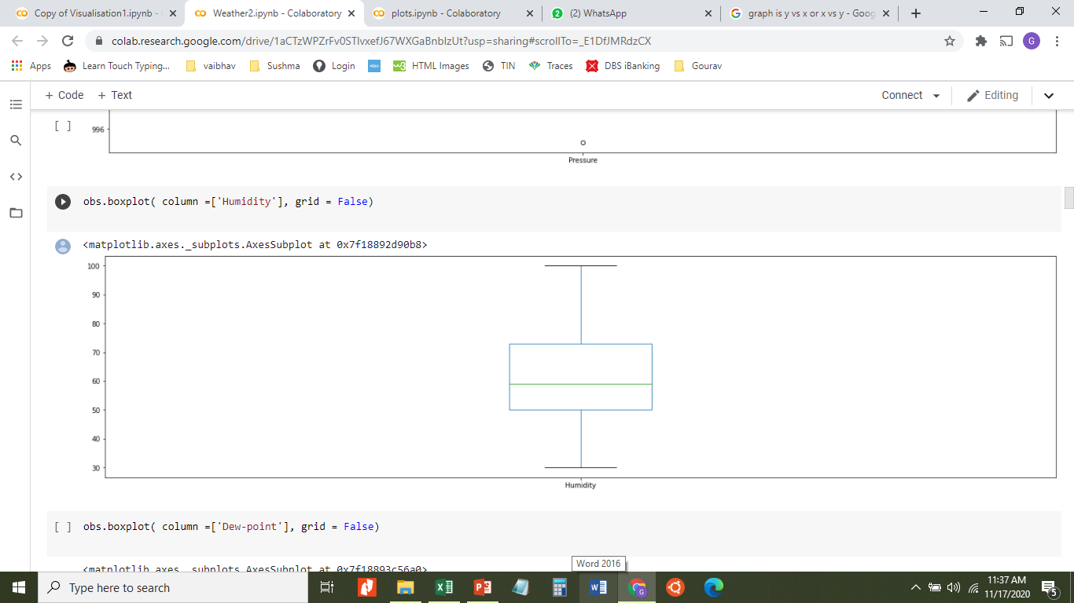
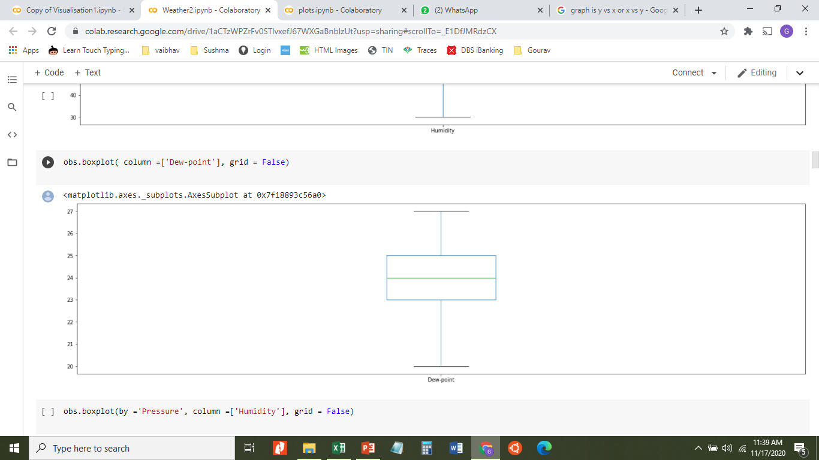
Data Visualisation-Box Plot 1
Using the code on the right, we can get a boxplot for the temperature ,pressure , humidity and dew point.
We can try to see if there is any visible trend in the data.

Slide 25

Data Visualization-Box Plot 1
This is how the box plot appears for temperature

Slide 26
Data Visualization-Box Plot1
This is how the box plot appears for humidity

Slide 27
Data Visualization-Box Plot1
This is the box plot for the dew point

Slide 28
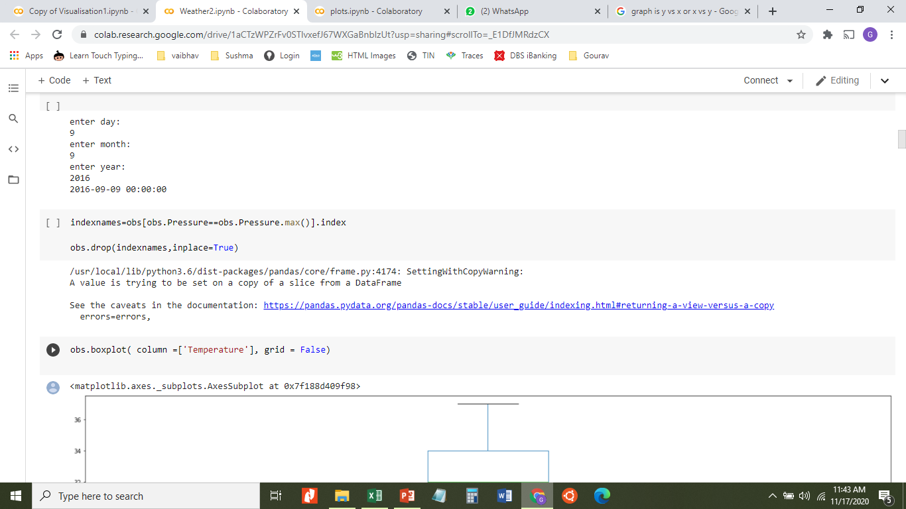
Data Visualization-Box Plot1
The box plot for the pressure has an outlier. There is the outlier for pressure of the maximum value. Therefore we are removing it from the dataset. After applying the below code that outlier is dropped.

Slide 29
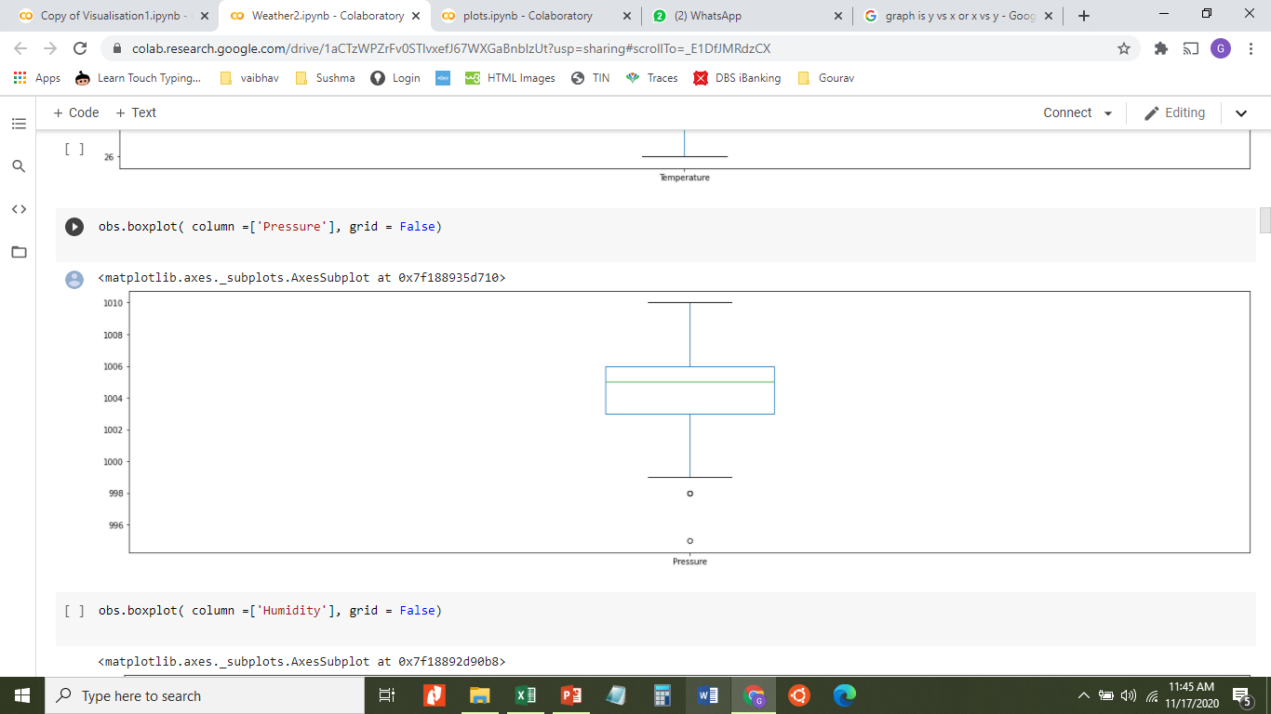
Data Visualization-Box Plot1
This is the box plot for pressure after removing the outlier

Slide 30
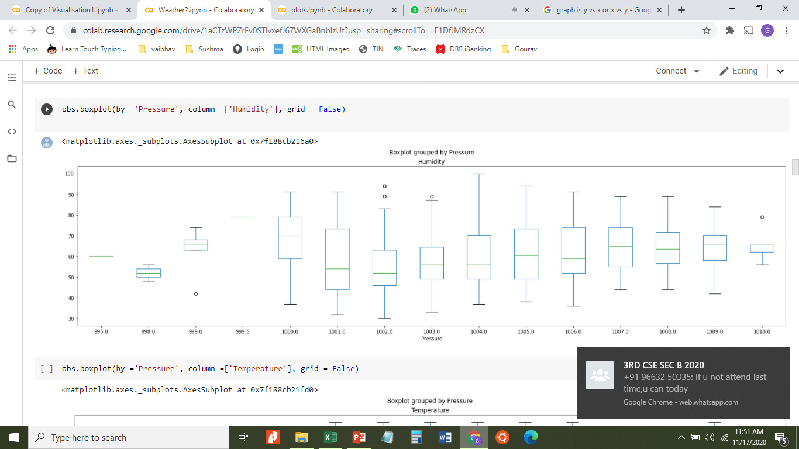
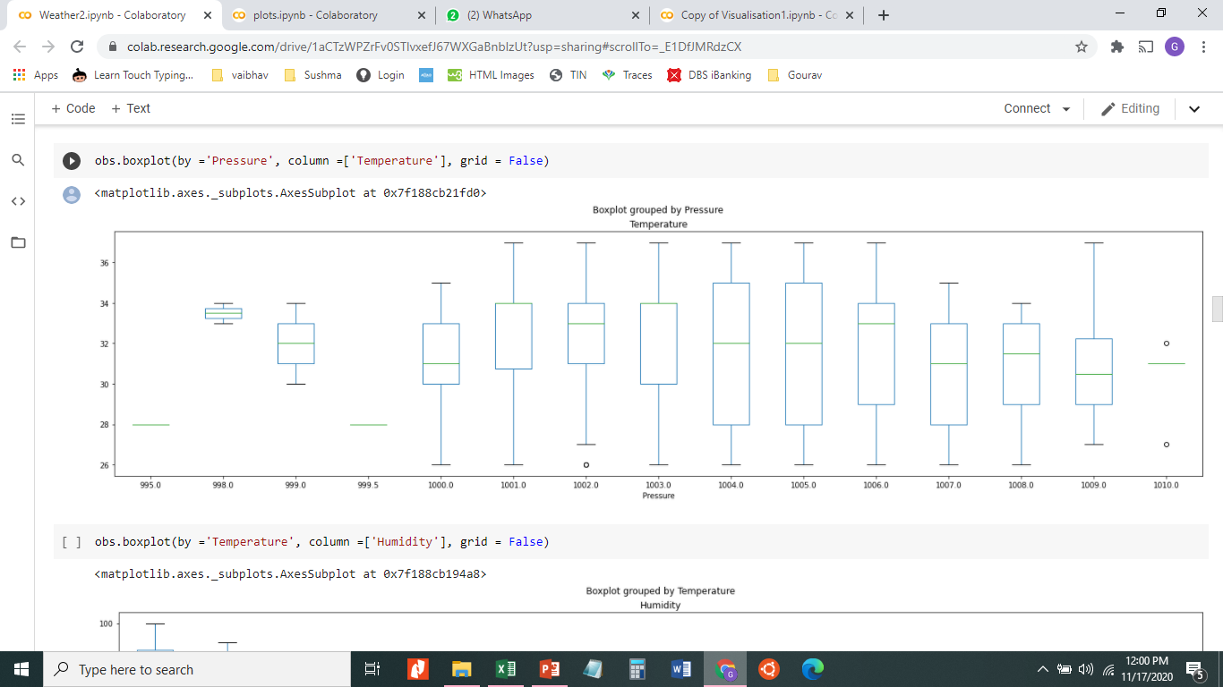
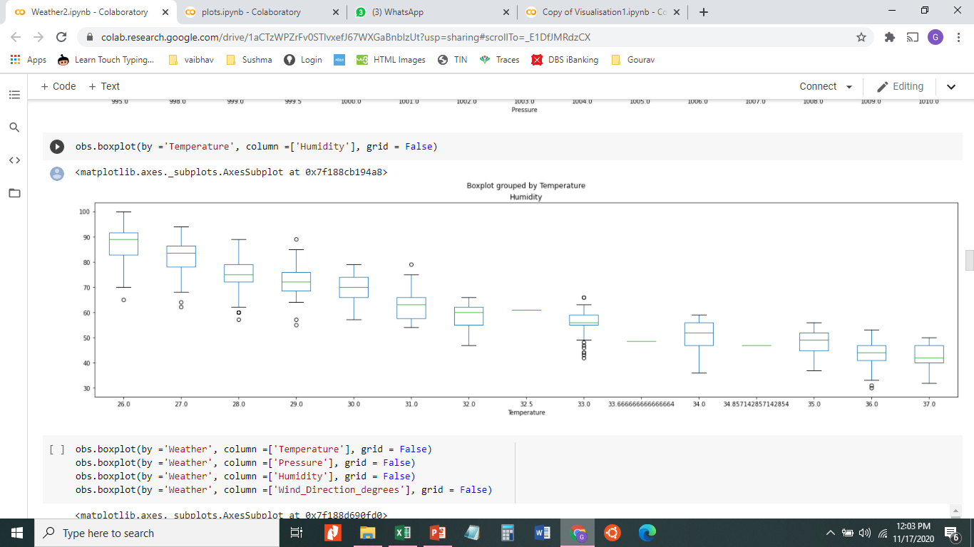
Data Visualization-Box Plot 2
Then we decided to come up with boxplots comparing two factors. We have compared two factors taking one against the other in the box plots. We use the following code for the box plots comparison.

Slide 31
Data Visualization-Box Plot 2
This is the boxplot of Humdity vs Pressure

Slide 32
Data Visualization-Box Plot 2
This is the boxplot of the Pressure vs Temperature

Slide 33
Data Visualization-Box Plot 2
This is the boxplot for Temperature vs Humdity

Slide 34
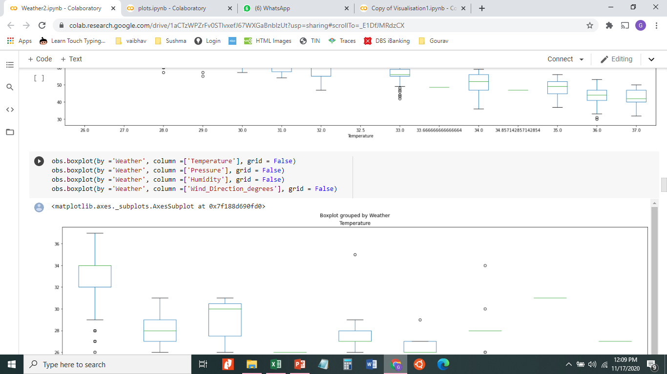
Data Visualization-Box Plot 3
We then decided to compare the weather conditions against each of the factors that we have considered.

Slide 35
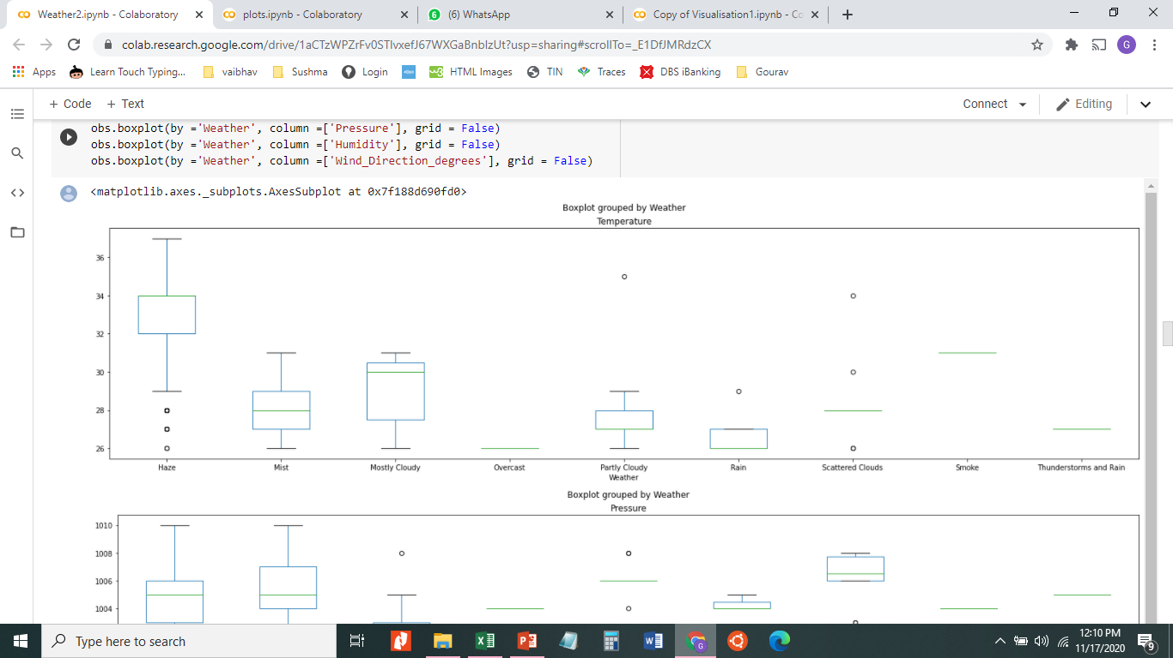
Data Visualization-Box Plot 3

Slide 36
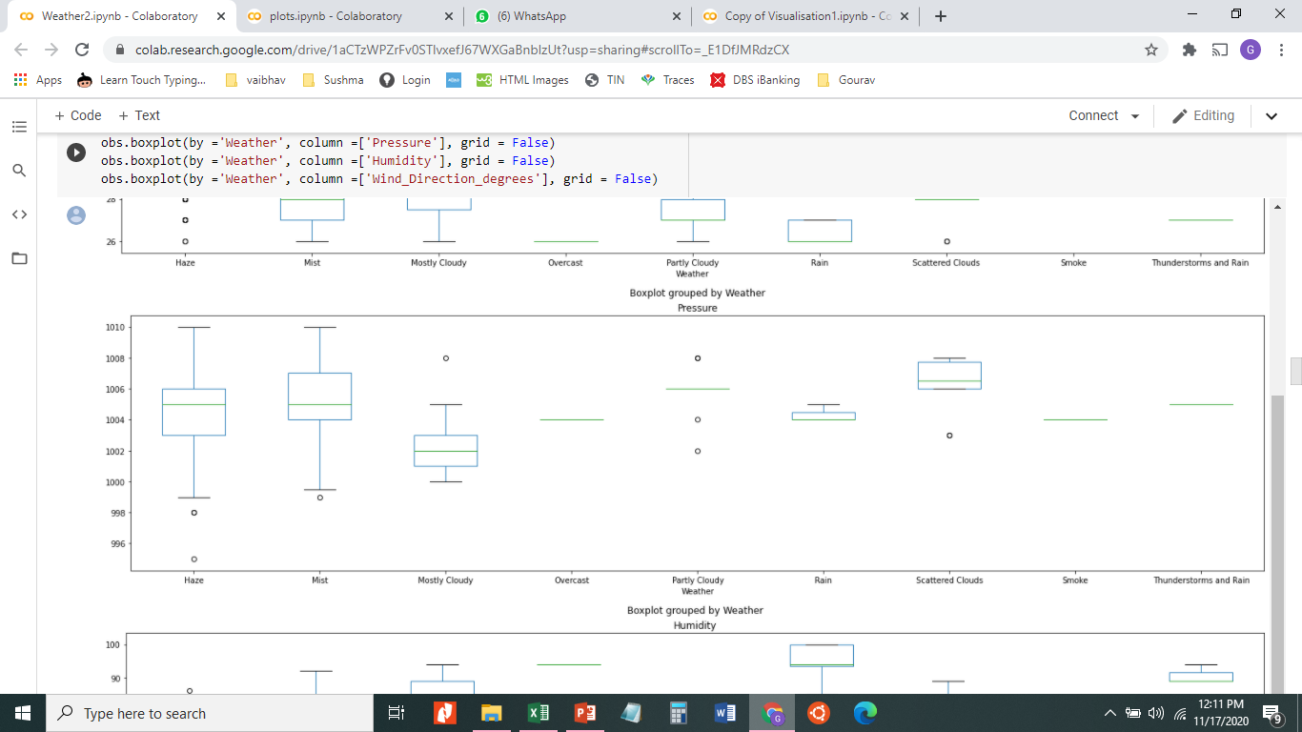
Data Visualization-Box Plot 3

Slide 37
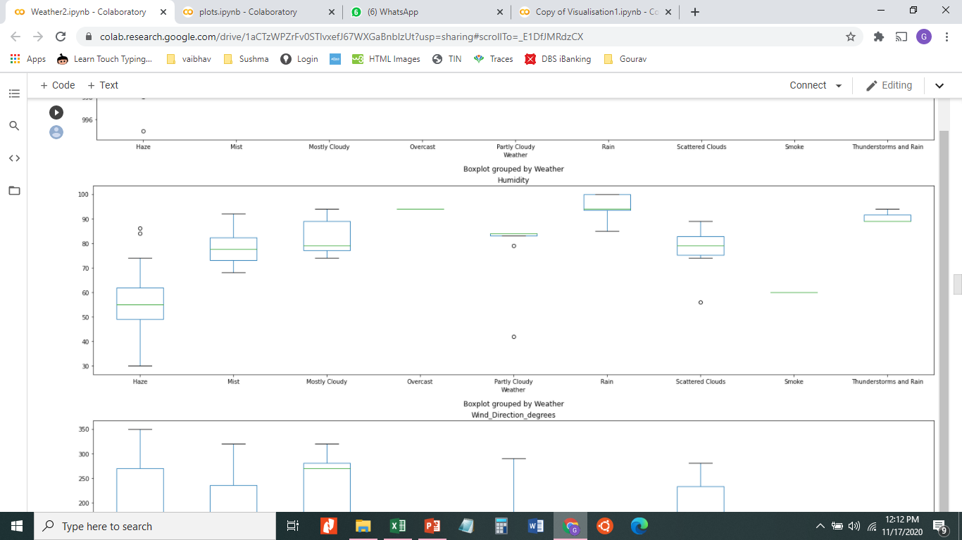
Data Visualization-Box Plot 3

Slide 38
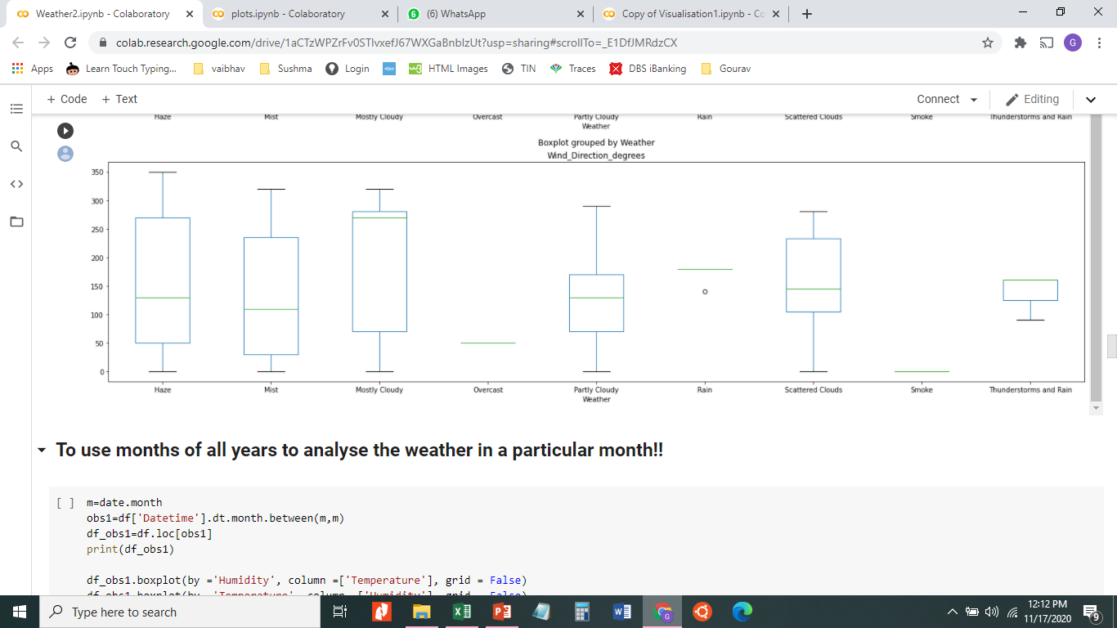
Data Visualization-Box Plot 3

Slide 39
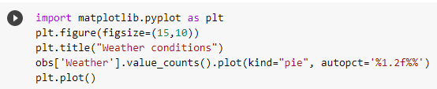
Data Visualization-Pie chart 1
For better understanding of what is the proportion of the weather conditions we have taken a pie chart

Slide 40
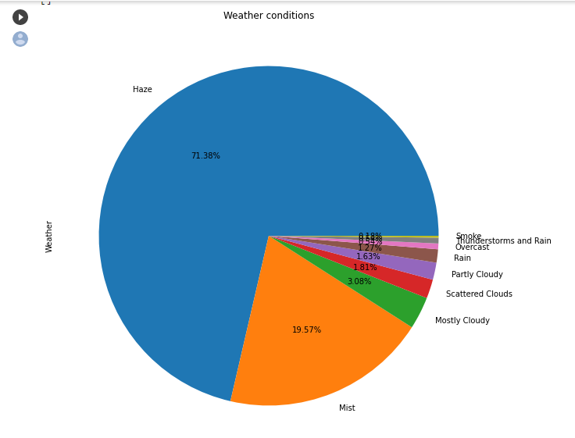
Data Visualization-Pie chart 1

Slide 41
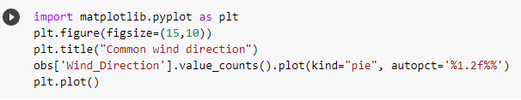
Data Visualization-Pie chart 2
We also wanted to see the distributon of the wind directions throughout the month and we implemented a pie chart for that also.

Slide 42
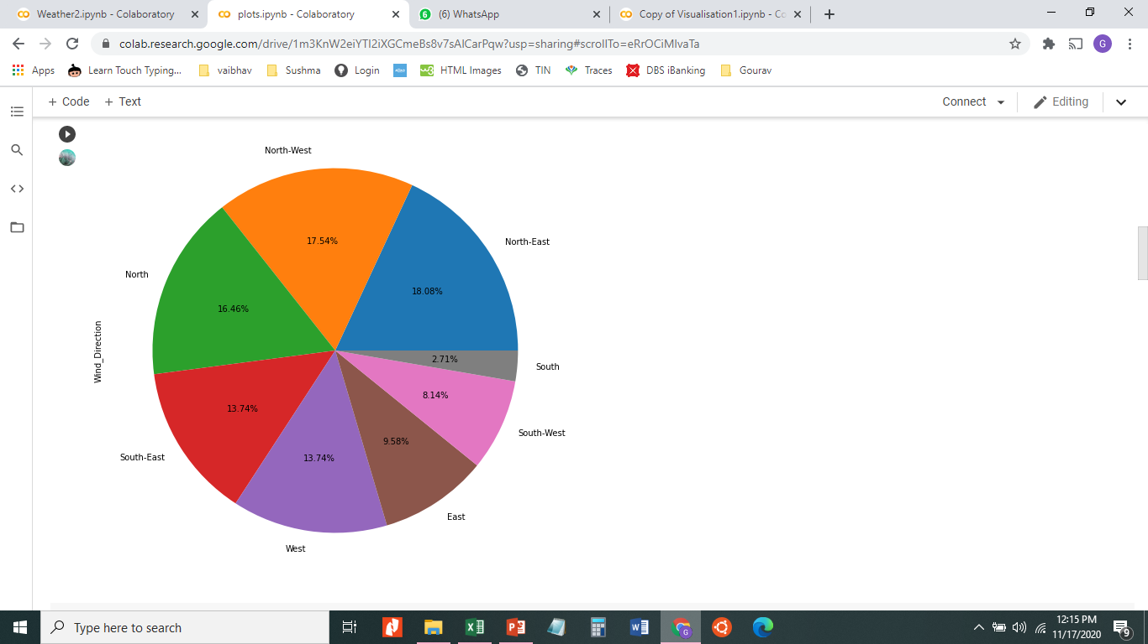
Data Visualization-Pie chart 2

Slide 43
Selecting the dataset
Choosing an appropriate sample
Normalization and Standardization
Cleaning the dataset
Data Visualization
Hypothesis Testing and Correlations

Slide 44
Normalization and Standaradization
We initially didn’t know whether the data was a normal one, we decided to do normalization first. We used the lambda method of normalization. We used the code in the next slide to do the normalization then visualized the data using line graphs. We then did standardization to get some normal plots.
Using the normalized data and the visualization we have done till now we can come up with inferences and hypothesis.

Slide 45
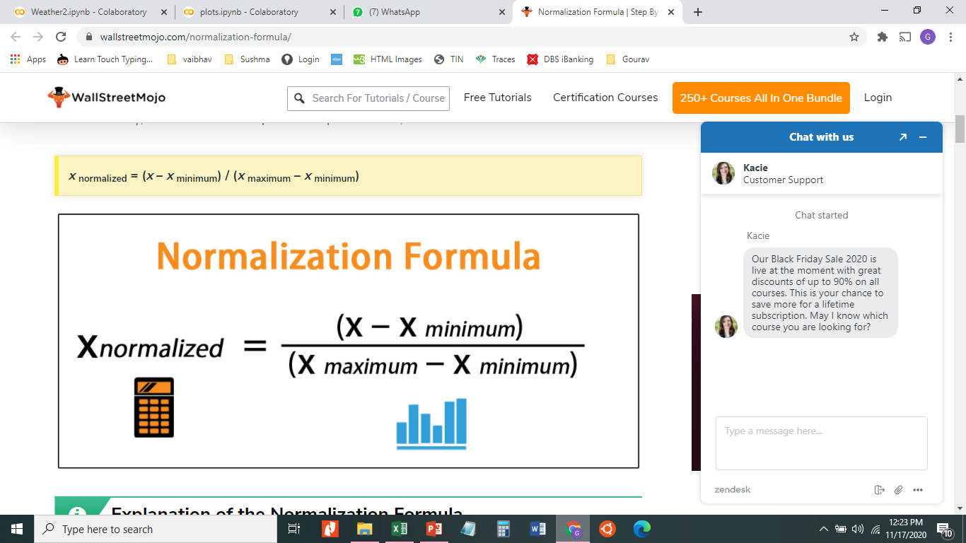
Normalization
We decided to use the lambda method for the normalization of our data. The lambda method uses the formula in the right to normalize the data.

Slide 46
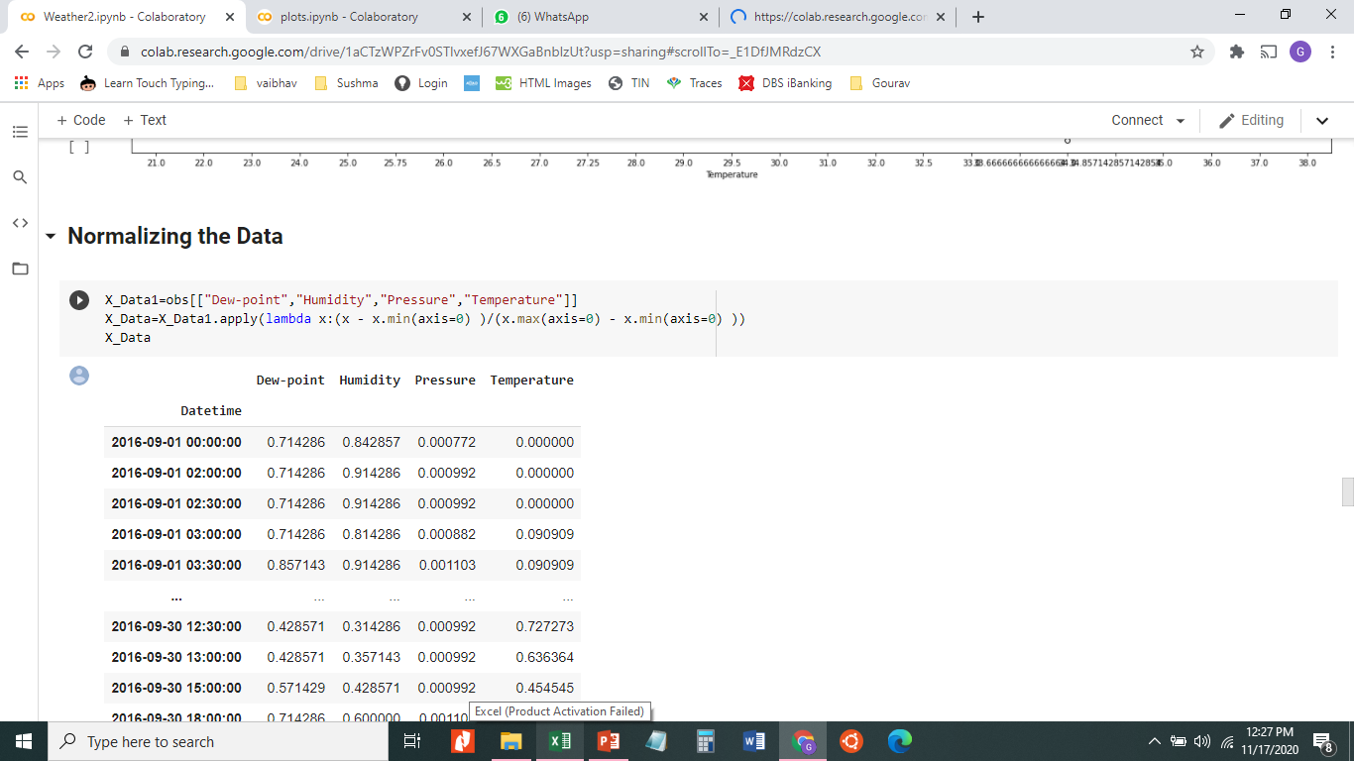
Normalization
We used the below code to normalize the data using the lambda method

Slide 47
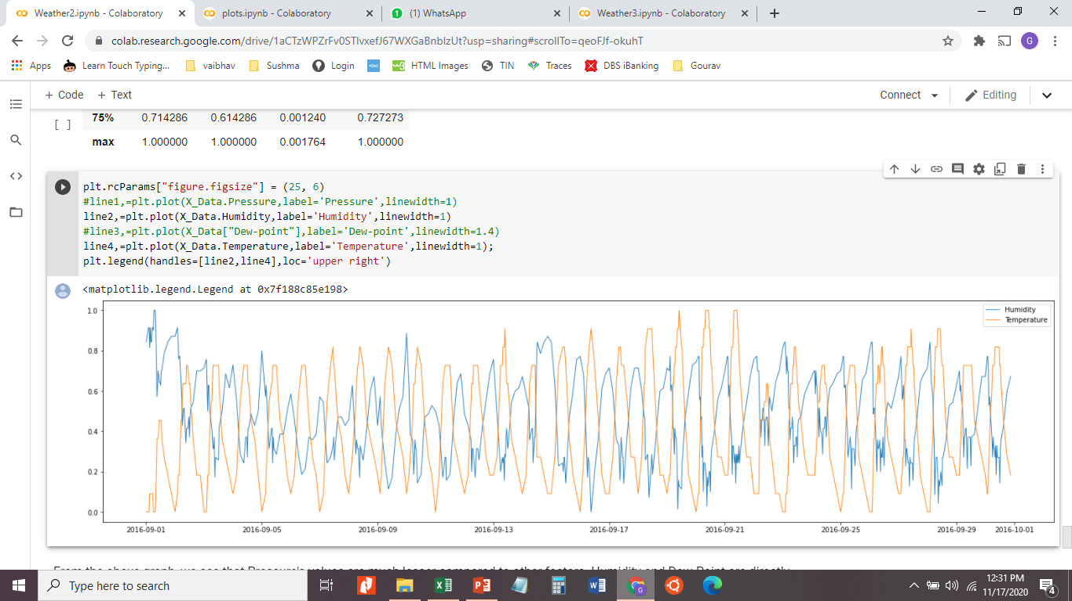
Normalization- Line Graph
We then visualized it using some line graphs. We have done a line graph that can compare between any two factors that we select. We have seen a relation between the humidity and the temperature.

Slide 48
Normalization- Line Graph
This is the line graph comparison of humidity and temperature

Slide 49
Standardization
We then did the standardizarion of the data to get the normal plots and the Gaussian curve to show that our data is normally distributed.
We have done this for all the 4 factors that we considered to find a relation in. We have done in the order of temperature, pressure, humidity and dew point.

Slide 50
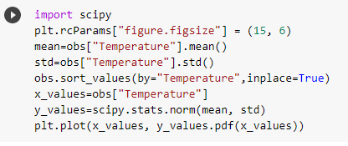
Standardization-Temperature
Code:

Slide 51
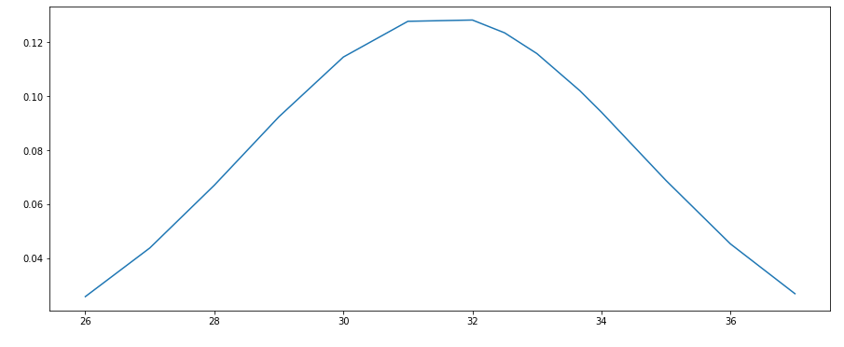
Standardization-Temperature

Slide 52
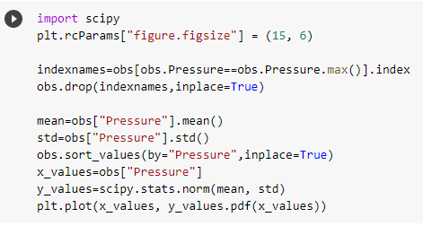
Standardization-Pressure
Code:

Slide 53
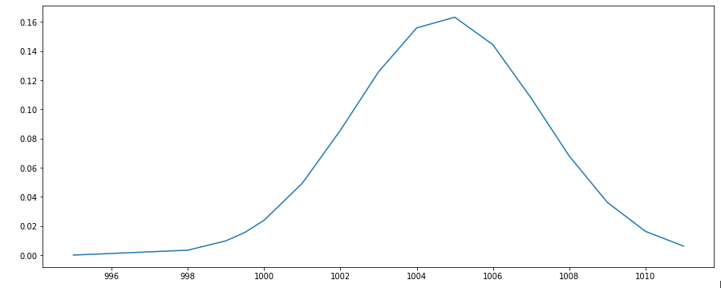
Standardization-Pressure

Slide 54
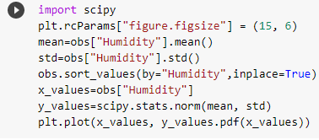
Standardization-Humidity
Code:

Slide 55
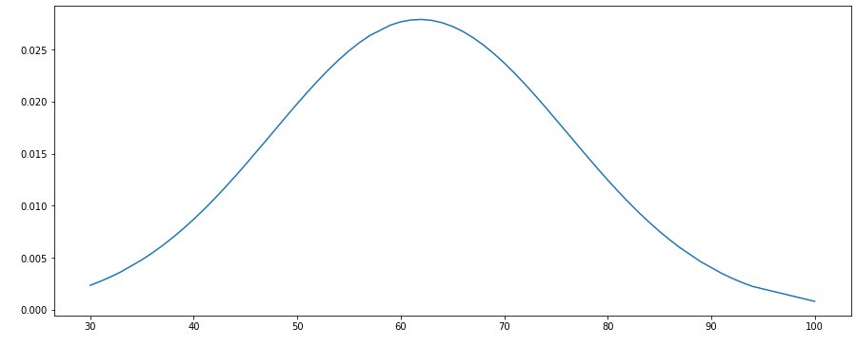
Standardization-Humidity

Slide 56

Standardization-Dew Point
Code:

Slide 57
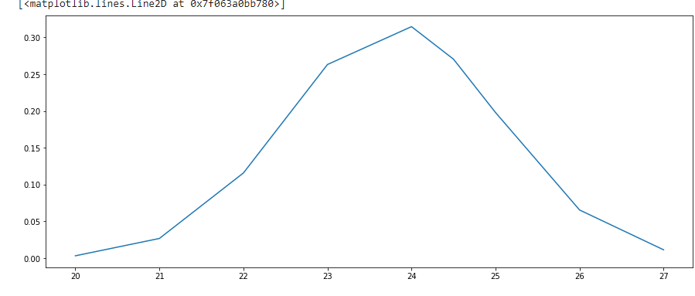
Standardization-Dew Point

Slide 58
Selecting the dataset
Choosing an appropriate sample
Normalization and Standardization
Cleaning the dataset
Data Visualization
Hypothesis Testing and Correlations

Slide 59
Hypothesis testing
We have two Null hypothesis we want to test.
1)We have considered the temperature as our factor here. We would like to say with a guarantee of 0.05 that the temperature will not cross 38 Degree celsusis? Can we trust this guarantee?
2)We have considered the humidity as our factor here. We would like to say with a guarantee of 0.05 that the humidity cannot be below 33%? Can we trust this guarantee?

Slide 60
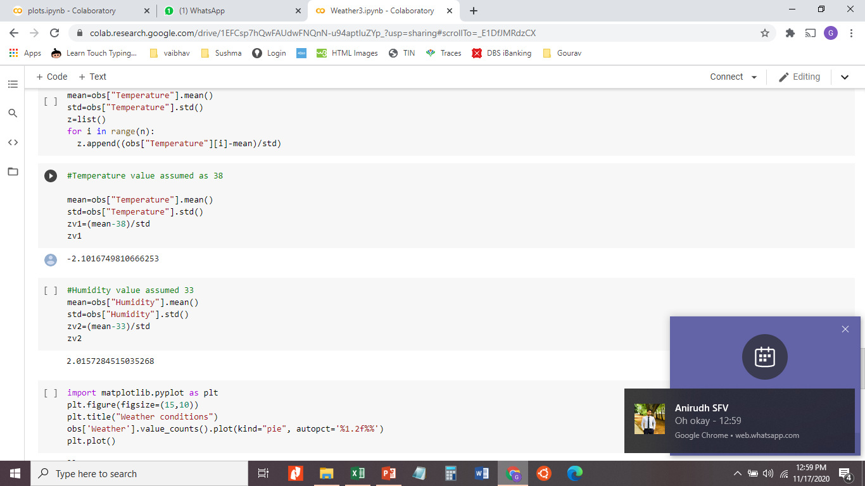
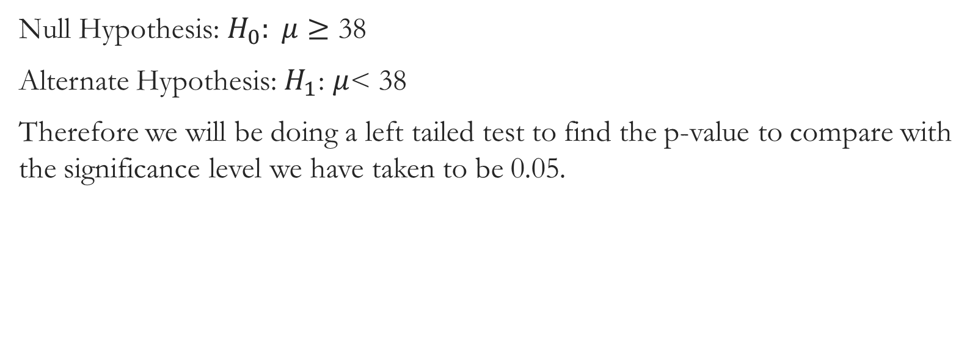
Hypothesis Testing-1
Null Hypothesis: $H_{0}: μ≥$ 38
Alternate Hypothesis: $H_{1}$: $μ$< 38
Therefore we will be doing a left tailed test to find the p-value to compare with the significance level we have taken to be 0.05.

Slide 61
Hypothesis Testing-1
Since we saw the z-value that we got is -2.10 and this is a left tailed test we have to consider thet p-value to be that the p(z<-2.10)=0.0179.
Since the significance level>P-value, we can reject our null hypothesis and say that the temperature cannot cross above 38 degree celsius in the month of September.

Slide 62
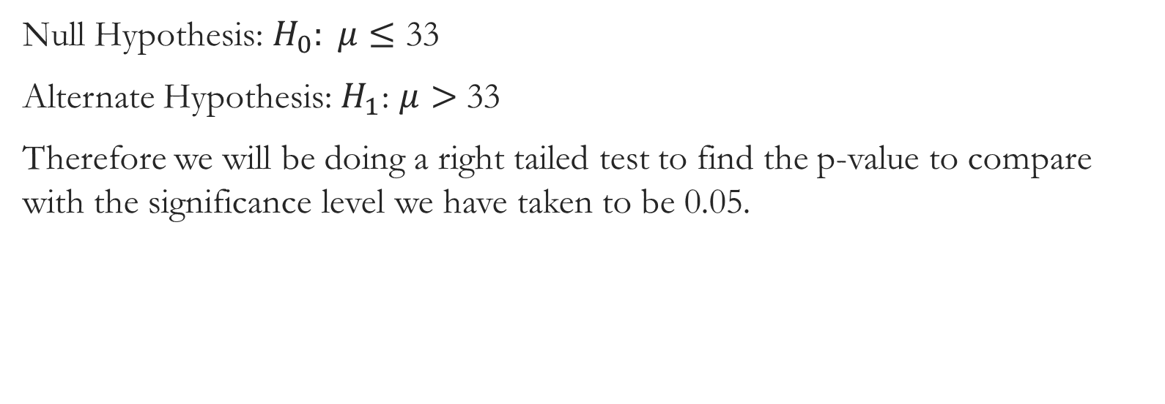
Hypothesis Testing-2
Null Hypothesis: $H_{0}: μ≤$ 33
Alternate Hypothesis: $H_{1}$: $μ>$ 33
Therefore we will be doing a right tailed test to find the p-value to compare with the significance level we have taken to be 0.05.

Slide 63
Hypothesis Testing-2
Since we saw the z-value that we got is 2.01 and this is a right tailed test we have to consider that p-value to be that the p(z>2.01)=0.0222
Since the significance level>P-value, we can reject our null hypothesis and say that the humidity cannot go below 33% in the month of September.

Slide 64
Correlations-1
The first correlation we have thought is between humidity and temperature. We notice a trend in the graph that is clear. It shows that these two factors are inversely proportional to each other. We shall see the line graph for these two factors to strengthen the fact that they are inversely proportional.

Slide 65
Correlations-1

Slide 66
Correlations-1
We can clearly see from this line graph that as humidity is increasing, the temperature is decreasing. As the temperature increases we can clearly see that the humidity decreases. Therefore we can conclude that temperature and humidity are inversely proportional.

